Slide 1
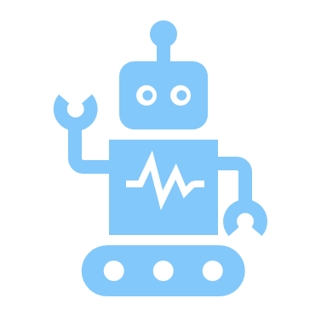
overview to AI (Artificial intelligence)
Artifical Intelligence, Or AI, Means making Computer think and act like humans. It helps Machines learn, Solve problems, and make decisions.
Examples include Robots, Smart assistants, And Chatbots.

Slide 2

A SHORT HISTOY OF AI
The idea of AI started in 1950s scientists when scientists dreamed of creating machines that could think like humans. In 1956, the term “Artificial Intelligence” was first used.
In the 2000s, AI became more powerful due to faster computers and Big Data.
Today, AI is everywhere likewise In Phones, Cars, Hospitals, and even in Homes.

Slide 3
Types of ai
There are mainly three types of AI :
Narrow AI : Works for one specific task E.g Face Recognition, Vioce Assistants.
General AI : Can think, learn, and Understand like a Humans still being developed.
Super AI : Smarter than humans which can exist in the future.

Slide 4

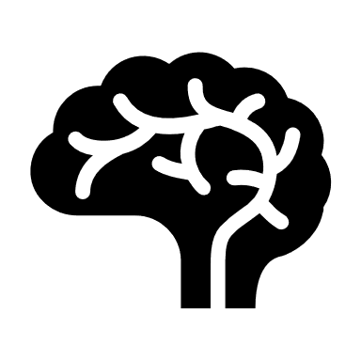

How ai works
AI works through Data and Algorithms.
It learns from large amounts of Data and improves its Performance over time.
Machine learning and development learning are the main techniques used in AI to help system learn automatically.
The more information AI gets the Smarter it becomes.

Slide 5
Ai in daily life
AI is already part of our daily routines.
Chatbots answers our questions online.
Google maps helps us find directions.
Smartphones recognize our faces.
Youtube and Netflix suggest videos we like.
Self driving cars can drive without any specific Human.

Slide 6




Ai in different fields
AI is used in many areas to make work faster and easier :
Education : Personalized learning for Students.
Health Care : Detecting diseases, and helping Doctors.
Business : Improving customer service and Marketing.
Agriculture : Smart farming using sensors and drones.
Security : Face and Voice recognition systems.

Slide 7

BENEFITS OF AI
Here are some benefits of AI (Artificial Intelligence) :
AI performs tasks faster and more accurately.
Helps people in dangerous jobs like Mining and Space work.
It reduces Human Errors and saves time.
Increases productivity in Businesses and industries.
Provides better decision making using Data.

Slide 8
Challenges of ai
AI might replace human jobs in the future.
Too much dependance on AI can make humans lazy or less creative.
It can be expensive to develop and maintain.
Privacy and security issues may occur.
AI can make mistakes if data is wrong.
There is a risk of people misusing AI technology.

Slide 9

Ethics and responsibilities in AI
AI should be always used in a fair and responsible way.
Developers must make sure AI does not harm people or invade Privacy.
Ethical AI means being honest, transparent, and safe in how it is used.
The goal is to make AI help society not control it.

Slide 10
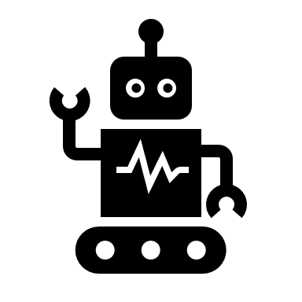


The future of ai
The Future of AI is full of possibilities.
AI will continue to grow and become more intelligent.
It may change the way we work, learn, and live.
If used responsibally, AI can make life safer, smarter, and more comfortable for everyone.

